Slide 1
When doing Data Science, it’s important to know how to analyze the disparity of a dataset
.
Disparity is when the data in a dataset is unbalanced.
For example, if you measure the age of people in a children’s playground where there are 20 children and 6 adults. The age of these people will be disparate.

Slide 2
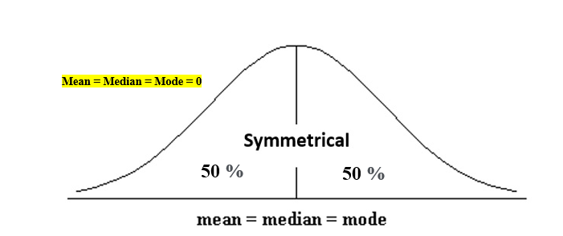
Skewness essentially measures the symmetry of the distribution
The normal distribution helps to know a skewness. When we talk about normal distribution, data symmetrically distributed. The symmetrical distribution has zero skewness as all measures of a central tendency lies in the middle.

Slide 3

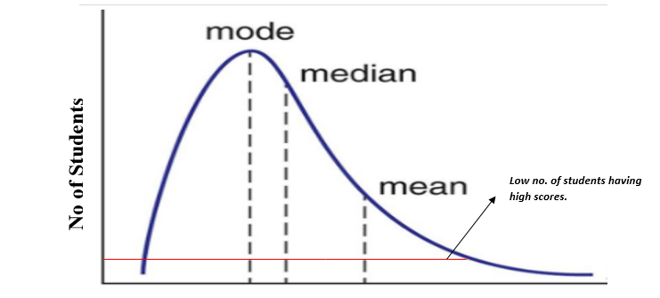
Types of skewness
Positive skewed or right-skewed

Slide 4

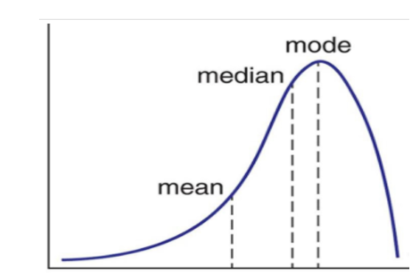
Negative skewed or left-skewed

Slide 5
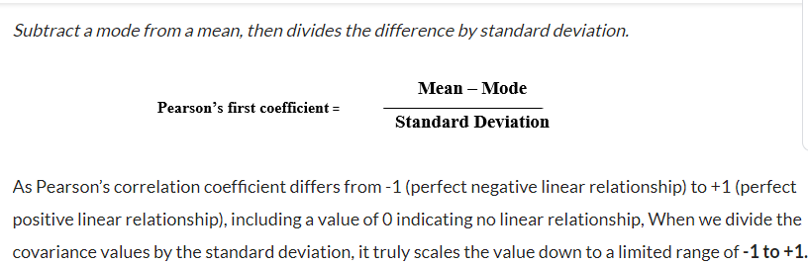
Calculate the skewness coefficient of the sample

Slide 6
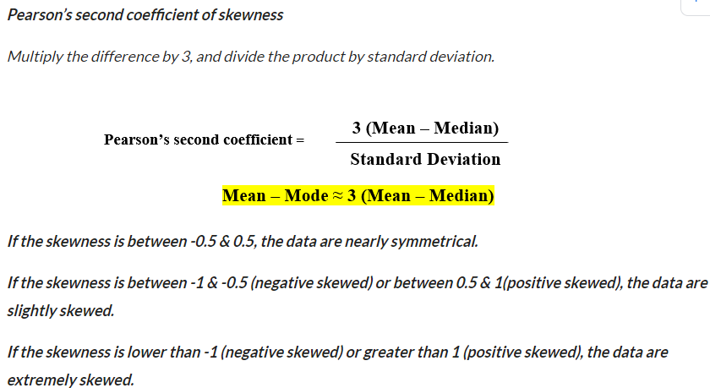

Slide 7
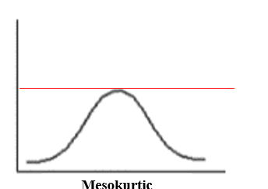
Kurtosis is a measure of the tailedness of a distribution
Types of kurtosis
A mesokurtic distribution is medium-tailed, so outliers are neither highly frequent, nor highly infrequent.
Mesokurtic (kurtosis same as the normal distribution).

Slide 8
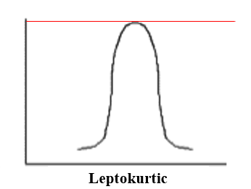
Leptokurtic (kurtosis > 3)
Leptokurtic is having very long and skinny tails, which means there are more chances of outliers. Positive values of kurtosis indicate that distribution is peaked and possesses thick tails. An extreme positive kurtosis indicates a distribution where more of the numbers are located in the tails of the distribution instead of around the mean.

Slide 9
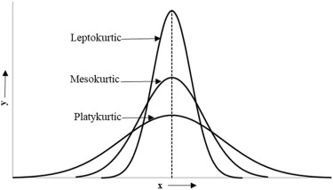
platykurtic (kurtosis < 3) A platykurtic distribution is flatter (less peaked) when compared with the normal distribution.

Slide 10
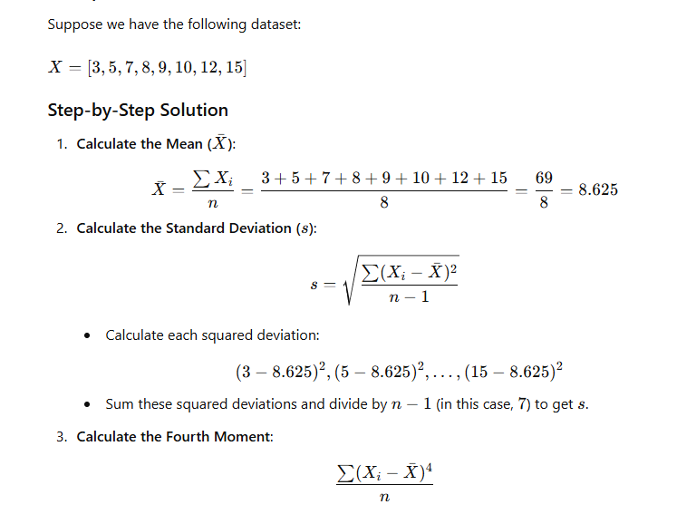

Slide 11
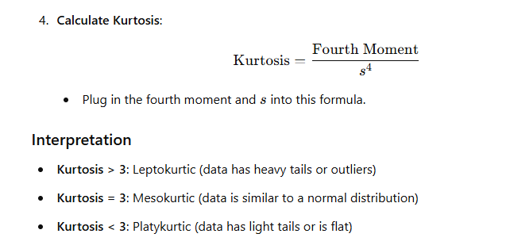

Slide 12
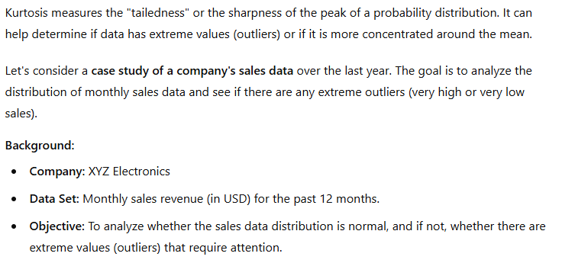

Slide 13
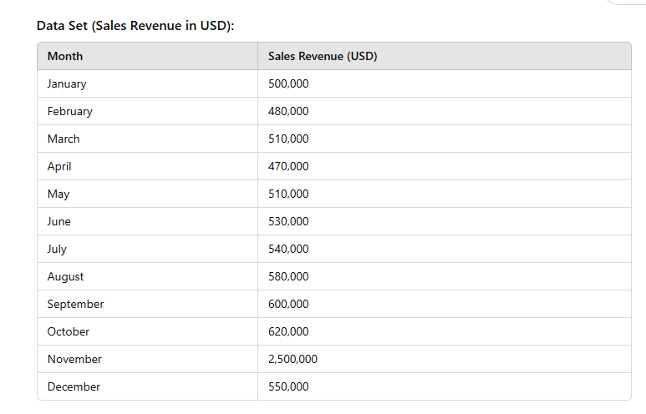

Slide 14
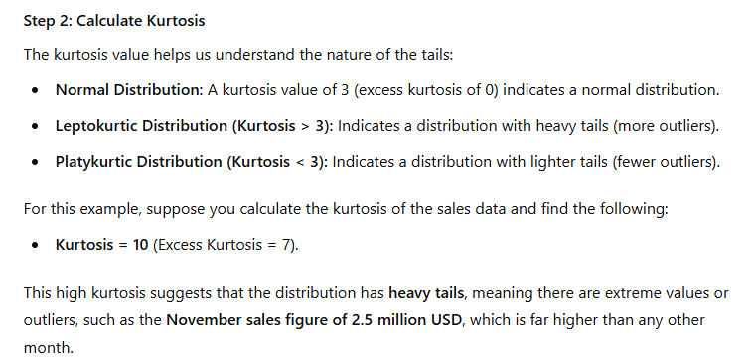

Slide 15
